Slide 1
CSS3 Animation
IN712 Web 3 2015
Session 8.2
Notes:
A really distinctive new addition to CSS. More than “paving the cow paths”

Slide 2
In-Browser Animation
HTML5
<canvas>
CSS3
Transforms
Translation
Keyframes
Notes:
When complex animation (i.e. more than multi-frame gifs) hit the web, it was via java applets and flash.
Browsers can’t actually render either of these by themselves. They require plug-ins (e.g. Flash Player) which hurt performance, and can be missing or turned off.
So HTML5 and CSS3 have introduced animation facilities supported directly by the browser. Like some other features of the new standards, not all of this is supported by all commercial browsers, but lots of it is by many. We will continue working with FireFox <latest version> for the usual reasons.
HTML5 introduces the <canvas> element. This is a normal tag that you drop in just like you drop in a <p> or <div>
The canvas element provides a full range of drawing commands much like those we use in Visual Studio: lines, points, arcs, images, etc.
You use these *from JavaScript*. That is, you pop a canvas into your html, then grab it in JavaScript via document.getElementById. You then invoke its methods in the usual OO way.
We will, therefore, defer discussion of HTML5 canvas animation until we meet JavaScript (starting in session 2 this week).
Today, we will turn our attention to animation facilities of CSS3, as shown.
Although not really programmable in the usual sense, you can do quite a lot of pretty amazing stuff with these new poperties.
You will notice that they actually have pushed the whole notion of CSS’s key:value pair structure about as far as it can go.

Slide 3
CSS3 Animation
Transforms
Translate, rotate, scale and skew
Not animations on their own
Applied directly on render, like other styles
Produce animation when combined with translations and keyframes
Notes:
The basis.
These are ordinary mathematical transforms.
They are not, in and of themselves, animations. However, when combined with transitions and keyframes (as we’ll see in a minute), they are used to generate complex visual behaviours

Slide 4

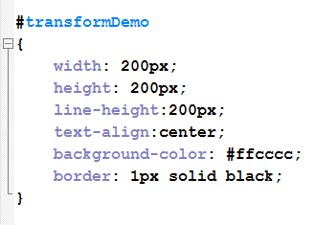
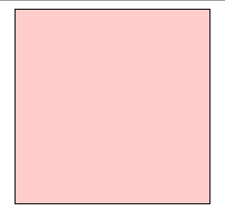
Transforms
Notes:
Assume this HTML and normal CSS to allow us to see the div
It appears in the browser as shown.
Now we can look at the effect of applying the transform styles.

Slide 5
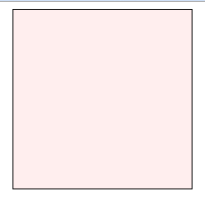
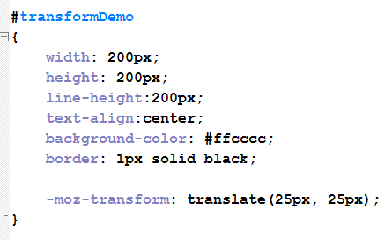
Transforms
Original was here….
Translate
Adding translate moves it here….
Notes:
Here we have added the vendor-prefixed transform style.
We give it the value translate which takes two arguments: an x distance and a y distance.
This simply moves the element from its original position (in this effect it is sort of like position:relative, but transform: is used for animation, and position: is not.
It is easy to get ‘translate’ and ‘transform’ confused because they sound so similar. Remember that we are applying mathematical trasnforms (the style) and those, as you know, are translate, rotate and skew (the values).

Slide 6
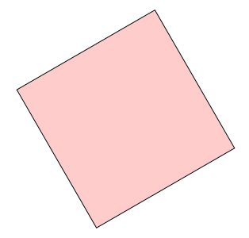
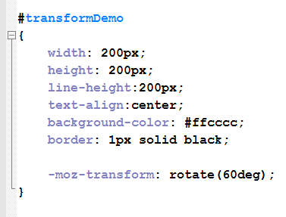
Transforms
Rotate
Notes:
What do you think would happen if you applied rotate and translate?

Slide 7

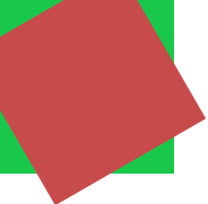
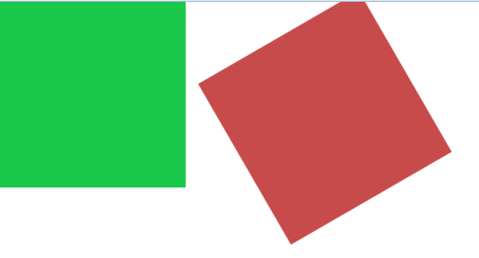
Transforms
Combining
Notes:
Here, I’ve used two divs to make it a little easier to see.
One is red and one is green. Both are absolute positioned at 0,0.
Transforms are applied to the red triangle. The green triangle sits there to serve as a reference.
Here you can see that if you use two separate transform statements, only the rotate is applied (translate would more the red square over 250 and down 25).
But, if you put both the transforms into a single style rule…
Both are applied

Slide 8
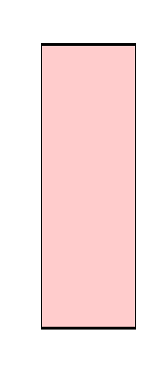
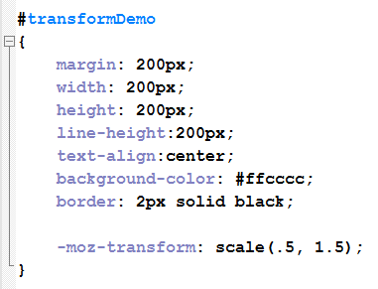
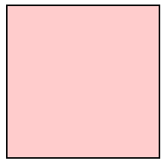
Transforms
Original was this size….
Scale
Adding scale changes it to ….
Notes:
Scale multiplies the x and y axis dimensions
Here, the x-axis (width) is reduced to .5 of its original, and the y-axis (height) is increased to 1 ½ times it original,

Slide 9
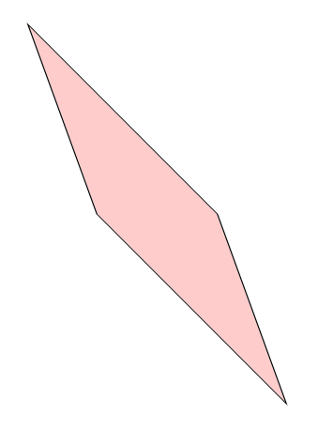
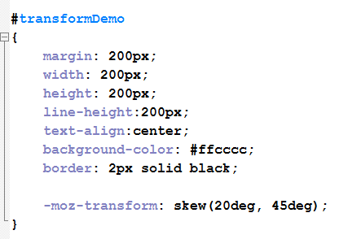
Transforms
Skew
Notes:
Give the skew in degrees on x and y axes.

Slide 10
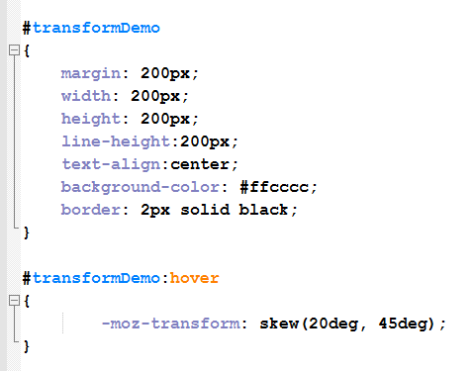
Changing on hover
Notes:
The simplest way to start animating with transforms is to define different states using the hover pseudoclass
(Although we usually only define hover on links, you can actually define it for most elements.)
Later, we will see more complicated behaviours with keyframes and javaScript event listeners, but hover is a good way to start experimenting.
Your CSS would look like this…
The screen would start as the regular square, and on mouse over would jump to the skewed version.
To get a proper animation, we need some intermediate frames (tweening).
That’s where the new CSS3 *transition* property comes in….

Slide 11
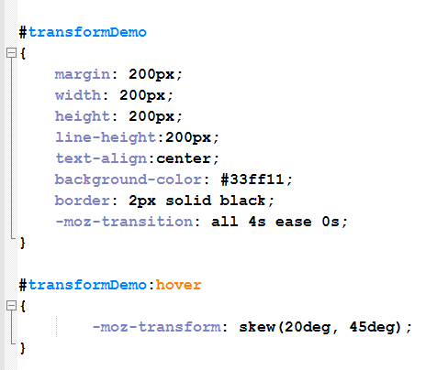
CSS3 Transition
Syntax:
transition: property duration timingFunction delay
Notes:
DEMO: #transformDemo
You apply transition like any other style. Then when something about the element changes (in this case, because the hover state is raised) that change is implemented with tweening as described by the arguments to transition.
The “transform on hover” behaviour we just saw is a change. Add transition, and the change (for example, from upright to skewed) gets tweened.
The arguments for transition are:
Property: You can animate individual properties – like width, height, color – separately, but usually you want to animate the whole object. For this, set the property to all
Duration: in seconds (e.g. 4s)
Timing function: describes the easing algorithm (change in speed of movement as you reach the end of the animation). Default is ease. See docs for details.
Delay: How long to wait before beginning the change.

Slide 12
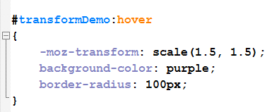
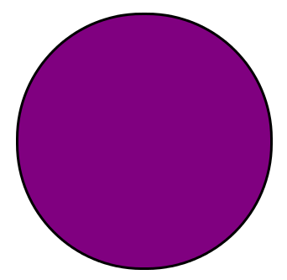
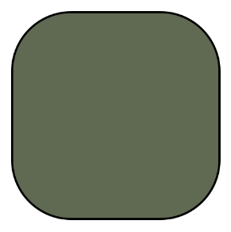
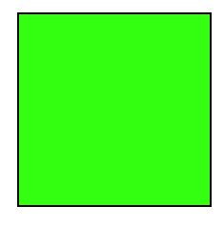
CSS3 Transition
Notes:
DEMO: #multipleTransition
You can animate all kinds of properties, not just the transforms.
For example…with this style on hover and the transition style as shown on the previous slide (all 4s ease 0s)
On mouseover you get a smooth 4 second animation as shown below (here we see only one of the intermediate states)
What do you expect will happen when the mouse is rolled off?

Slide 13
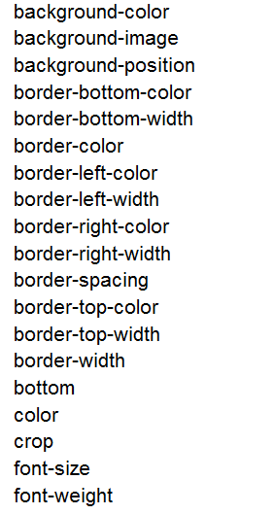
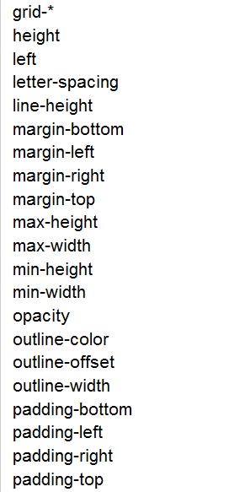
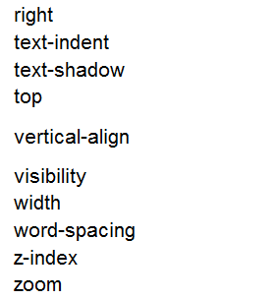
CSS3 Transition
Animatable properties
Notes:
So you can do fun stuff like DEMO: #textAnimation
We’ll be having a play with some of these in practical.
/* Basics */
#textAnimation
{
font-family: Calibri;
-moz-transition: all 4s ease 0s;
margin: 200px;
text-align:center;
}
#textAnimation:hover
{
-moz-transform: rotate(360deg);
font-size:6em;
color:goldenrod;
text-shadow: 3px 3px 5px black;
}

Slide 14
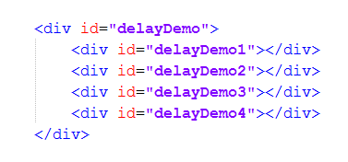
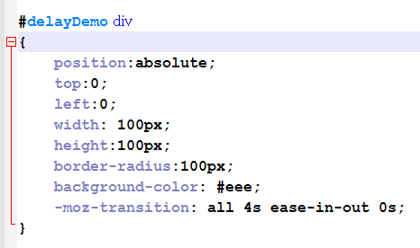
Transition Delay
Notes:
You can get some interesting effects with delay
For example, assume this HTML
A little styling in the CSS to make them all grey circles sitting on top of each other.
Then give them each a different transform and delay…

Slide 15
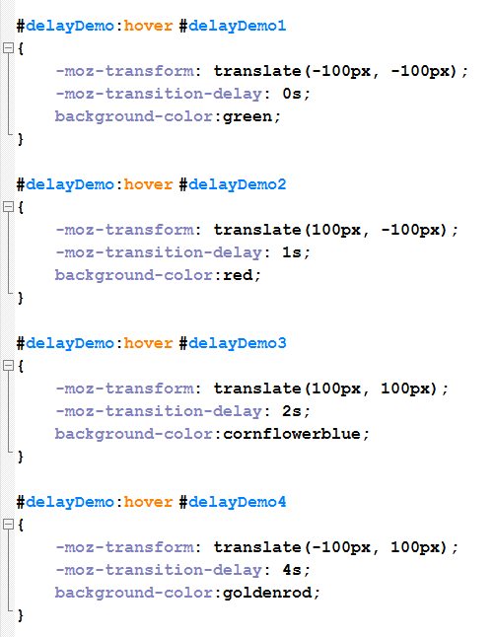
Transition Delay
Notes:
Then give them each a different transform and delay…
What happens on mouseover? What happens on “unmouseover”? (no delay)
DEMO: #delayDemo

Slide 16
CSS3 Keyframe Animation
Define the animation
@-moz-keyframes animationName
{
Keyframe specifications
}
Assign the animation
selector
{
Other styles
-moz-animation: name duration timing-function delay iteration-count direction;
}
Notes:
That was fun. But wait, there’s more….
Keyframe animation is exactly what it sounds like: you can define specific points in an animation, and the browser will tween them for you.
This is a two-step process: First we define the animation, then we assign it to an element.
Here are the templates…
Let’s look at each in turn…

Slide 17
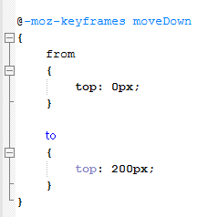
CSS3 Keyframe Animation
Define the animation
Notes:
Note the @. That is required. The selector without vendor prefix is @keyframes. This is an “at-rule”, or what we would call a compiler directive (more accurately here a parser directive). We will see a couple more during the semester. Here we are really extending the whole concept of a CSS style rule into something much closer to traditional coding.
This defines a simple animation with only two keyframes – starting and ending (we will see in a minute how to get more)
‘from’ and ‘to’ are keywords here, signifying the start and the end of a keyframe definition
You specify a property value for the start frame (from) and a property value for the end frame (to). You could have as many different properties specified as you needed (we’ll see a list of what can be animated in a minute)

Slide 18
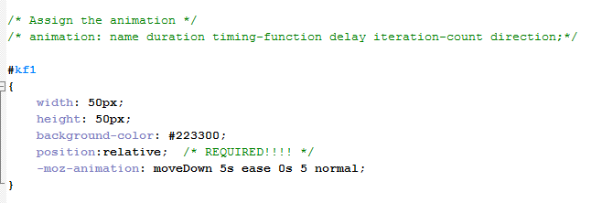
CSS3 Keyframe Animation
Assign the animation
Notes:
In our html we have a div id=kf1.
Here we style it, and we include its vendor-prefixed animation property with the 5 attributes.
What is moveDown? That’s the keyframe animation we defined on the previous slide.
When you open the page, the div moves up and down five times (see Demo kf1_2014.html).

Slide 19
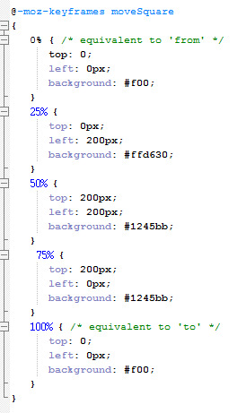
CSS3 Keyframe Animation
Multiple Keyframes
Notes:
Style each %age point.
Assign as before, using name “moveSquare”
(See demo kf2)

Slide 20
Today’s Practical
Notes:
See Demo keyframeAnimations.html

